Slide 1



AI Master Class series – Day 19
License Plate Recognition

Slide 2

License Plate recognition.
LPR (License Plate Recognition) is an image-processing technology used to identify vehicles by their license plates. This technology is used in various security and traffic applications, such as the access-control system featured in the following animation:

Slide 3

OpenALPR.
The OpenALPR CarCheck API is a hosted ALPR web service for application integration. Send images to the OpenALPR cloud servers and the response will be a JSON document describing the license plates, and vehicle variables such as color, make, and body type.
There are a number of plans that offer a fixed number of recognitions per month. Select a plan below.

Slide 4
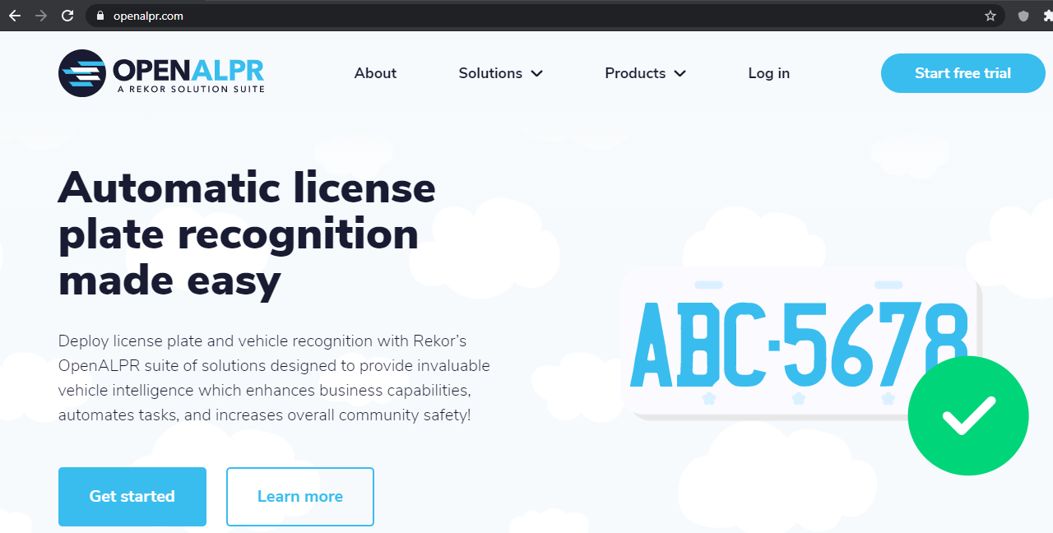

Slide 5
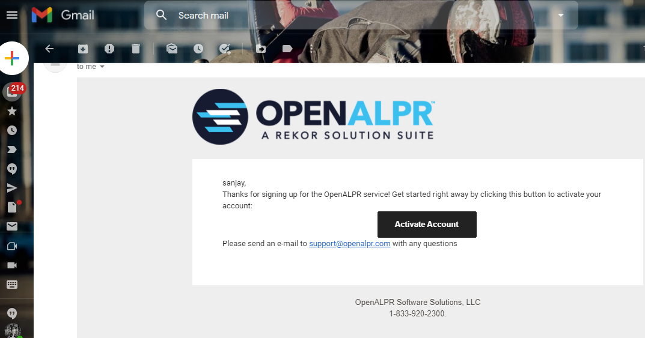

Slide 6
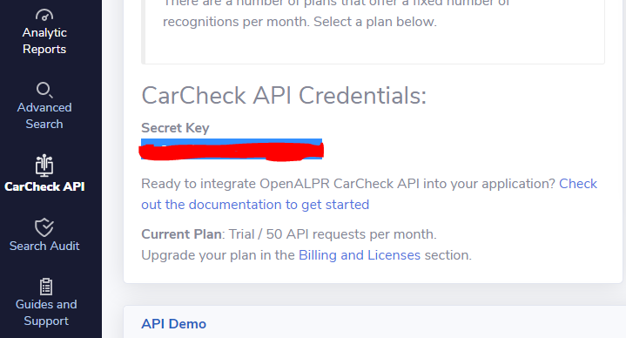

Slide 7

! PRACTICAL SESSION !
License Plate recognition using OpenALPR

Slide 8
ALPR FROM IMAGE

Slide 9
ALPR USING CAMERA

Slide 10

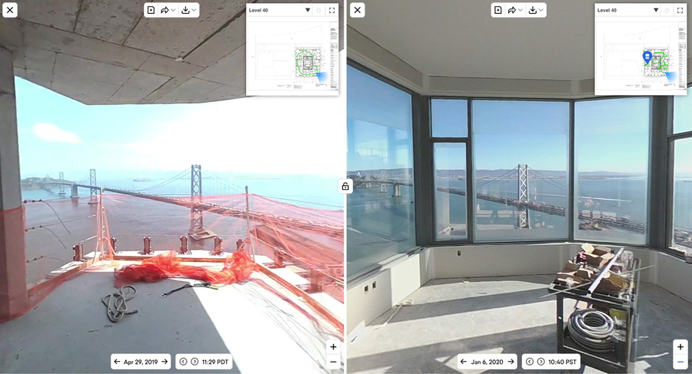
AI News – Day 19. 2020
The startup OpenSpace is using 360-degree cameras and computer vision to create comprehensive digital replicas of construction sites.

Slide 11
Thanks!
Tomorrow session
Do you have any questions?
sanjay@pantechmail.com
www.pantechsolutions.net
Drowsiness Detection

Slide 12
Day-19 Agenda.
01.
02.
03.
License Plate recognition
OpenALPR
LPR
04.
Q & A
LPR & Applciation
OpenALPR API
Deploying ALPR

